Slide 1
Mitigation Programs along the Upper Mississippi
Ron Davis
Illinois Department of Natural Resources / Office of Water Resources

Slide 2
Support your Local Floodplain Manager

Slide 3
FEMA Mitigation Programs
Hazard Mitigation Grant Program (HMGP)
Flood Mitigation Assistance (FMA)
PreDisaster Mitigation (PDM)
Public Assistance 406 Mitigation
Notes:
I’m going to breeze through these since most of you should be very familiar with them.

Slide 4
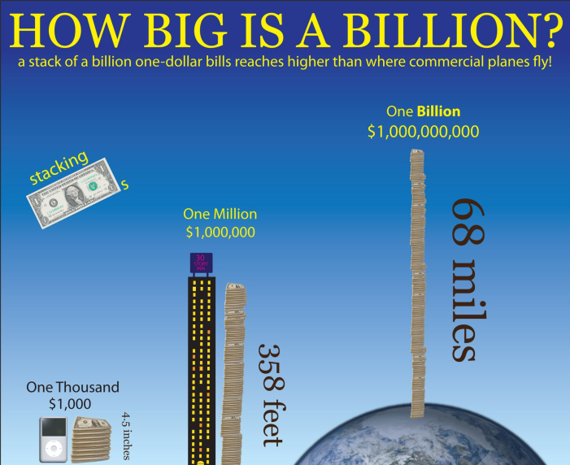
Hazard Mitigation Grant Program (HMGP)
Funds received after a Presidentially Declared Disaster
Based on FEMA spending on IA and PA
Either 15% or 20% if the State has an enhanced plan
Iowa, Missouri and Wisconsin have enhanced plans
Illinois - $211 Million
Iowa – $409 Million
Minnesota - $136 Million
Missouri - $270 Million
Wisconsin - $87 Million

Slide 5
Flood Mitigation Assistance (FMA)
Annual Nation-wide competitive Program
Funded with funds from the NFIP
Repetitive loss is a priority - All properties must have flood insurance
Community Level Flood Mitigation Projects are a priority
$160 million available
FEMA deadline for States is January 31 – Earlier for local jurisdictions

Slide 6
PreDisaster Mitigation (PDM)
Annual Nation-wide Competitive Program
$235 million available, $4 million limit per project
Funds available for planning
Funds are for All natural hazards
New – Advance Assistance funds to develop strategies and obtain data for future projects
FEMA deadline for States is January 31 – Earlier for local jurisdictions

Slide 7
State Hazard Mitigation Officers (SHMOs)
Illinois – Sam Al-Basha sam.m.al-basha@illinois.gov
Iowa – Aimee Bartlett aimee.bartlett@iowa.gov
Minnesota – Jennifer Nelson jennifer.e.nelson@state.mn.us
Missouri - Heidi Carver heidi.carver@sema.dps.mo.gov
Wisconsin – Robyn Wiseman robyn.wiseman@wisconsin.gov

Slide 8
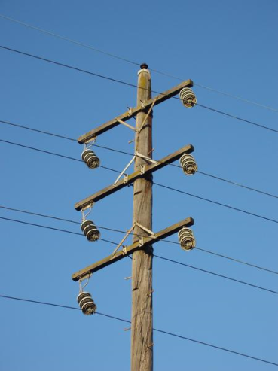
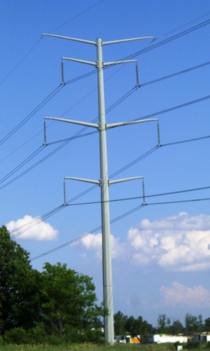
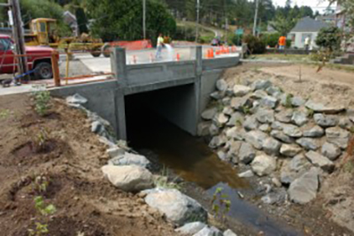
Public Assistance 406 Funds
This is the most underutilized mitigation program
FEMA is trying to gear up this program
After a disaster, when FEMA PA funds repairs to infrastructure, the jurisdiction can request funds to make the infrastructure more resilient.
No cap on the funds, but the must pass a B/C analysis
Not required, but identify projects in advance

Slide 9
Funds for Match or Stand Alone Projects
Home Owner funds -
Increased Cost of Compliance (ICC)
Local Funds
Regional Water
State Programs
Legislative Initiatives
HUD Funds
Non-Profits
Global Match
The Great Source of Funds hidden in plain view

Slide 10
The Great Source of Funds

Slide 11
Increased Cost of Compliance
Part of NFIP policies
Reimburses up to $30,000 for FRED
Floodproofing
Relocation
Elevation
Demolition
The demolition funds can be assigned to the jurisdiction and used for the non-Federal match

Slide 12
Local Funds
General Budget
Increase in taxes – Austin Minnesota
Contributed Labor - Value can be given to Officials and citizens volunteering for the project. This can usually cover the matching funds required for a plan.

Slide 13
Regional Organization
Metropolitan Water Reclamation District
Water District for Cook County area – protects the quality of water and protects from flood damage
$5 million a year for acquisition, from property taxes
They only fund purchase cost, not demolition nor acquisition costs
Can be used to match FEMA funds
They use a sliding scale for cost share – 100% for jurisdictions below median household income.

Slide 14
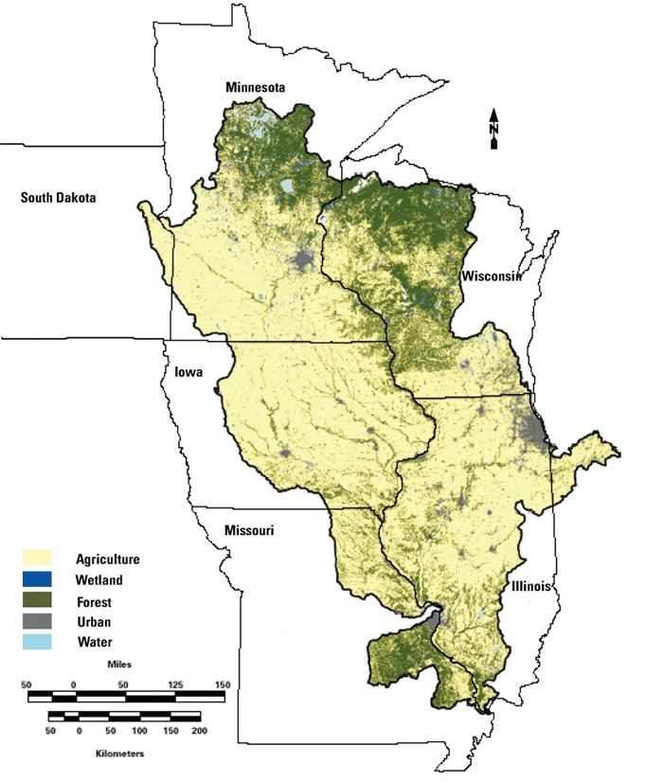
Upper Mississippi State Programs
Illinois
Iowa
Minnesota
Missouri
Wisconsin

Slide 15
Illinois Program
Began in the mid-70’s, maybe the first in the USA!
Legislature places funds in budget, because of this it varies greatly, currently about $20 million
Purchases and demolishes flood-prone structures
Is on a reimbursement basis
Cannot elevate structures or purchase mobile homes
Projects require a B/C and an environmental
Priority is to match FEMA funds
Can fund projects at 100%

Slide 16
Iowa Program
Two sources of funds – sales tax increment revenues and funds appropriated by the General Assembly
Used for structural projects. Acquisition only when part of a structural project. State funds have not been used to match acquisition projects.
Up to $15 million a year. Anywhere from $2.5 to $13 million
Requires a local match – minimum of 50%
Projects are approved by a board

Slide 17
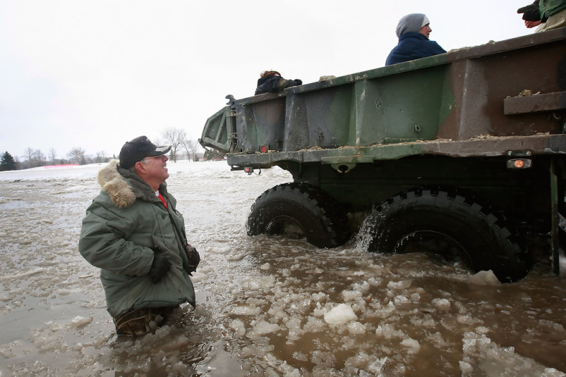
Minnesota Program
Flood Damage Reduction Grant Assistance Program
State provides match for FEMA mitigation through special allocation when there is a Federal declaration.
Cost share is a priority, can pay for acquisition, studies, elevations, levees, ring dikes and flood walls
Small projects $300k or less, the state limit is $150k
Large projects, above $150k, are presented to the governor and legislation.
Natural Resources budget funds can provide 12.5% match

Slide 18
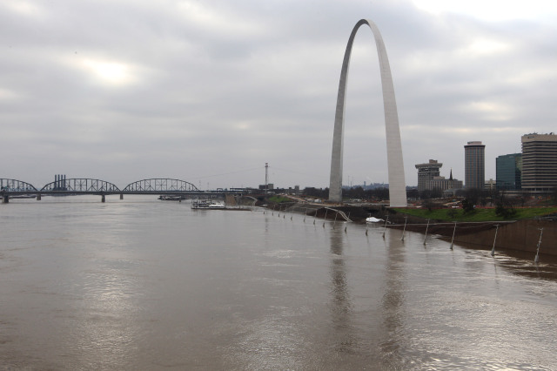
Missouri Program
Does not have a state program.

Slide 19
Wisconsin Program
Approved HMGP projects receive 12.5 % to provide match.
The local government must provide the other 12.5%
Reimbursement program
Maximum contribution is 50% of the costs
Can pay for elevations

Slide 20
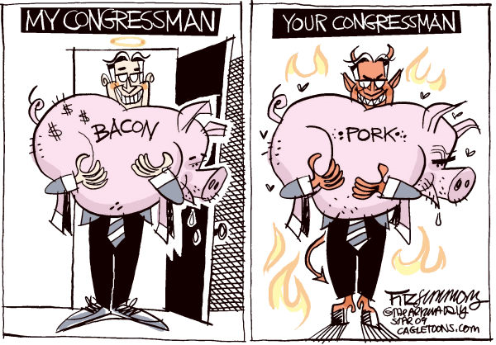
Legislative Initiatives
Extra funds allocated in the State or Federal budget
Can be directed to a specific jurisdiction or disaster
Make sure the legislation is written correctly

Slide 21
Federal Funds
Housing and Urban Development (HUD)
This is the big source for non-FEMA funds. Congress generally provides funds through HUD following very large disasters. They lose their federal identity when the reach the state and can be used for match
Small Business Administration (SBA) – homeowners can receive up to an additional 20% of their loan for mitigation measures.

Slide 22
Non-Profits
Has not proven to be a good source for funds
Non-profits are usually great sources for technical assistance but are not sources of significant funds
Non-Profits assist with planning Urban Land Institute, Public Entity Risk Institute, American Planning Association; Grand Victoria Foundation (Casino funds required by law)
Nature Conservancy – Want bigger areas of land

Slide 23
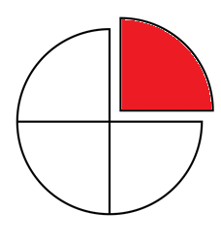
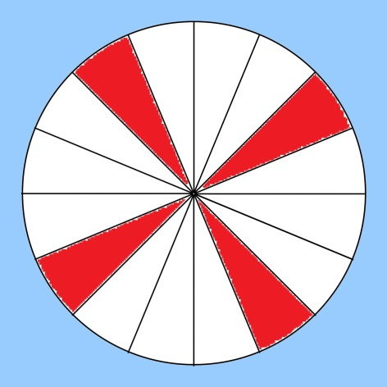
Global Match for FEMA Disasters
The overall disaster must meet the match requirements, but this allows the excess matching funds from one project can be used to match a different project.
Easier on matching partners. They can fund one project at 100% instead of 4 at 25%.
Possible to use large projects to assist in funding poor communities
Notes:
Glenview 9 million Local share $3 million Federal Share

Slide 24
Issues with Global Match
Everything must follow FEMA rules
All properties to be used as match must be approved by FEMA
Can’t start the project until FEMA approval
Some communities don’t want to begin the project until the matching funds have been spent
Illinois state budget crisis impacted match

